Slide 2

What Is Jeans for Genes Day?
Jeans for Genes Week 2026 in the UK takes place from Monday 14th to Sunday 20th September 2026.
Jeans for Genes is a charity that raises money to help children and families born with genetic conditions.
In 1994, the Gene Therapy Research Unit was developed. Jeans for Genes was created to help raise money and promote this research.

Slide 3

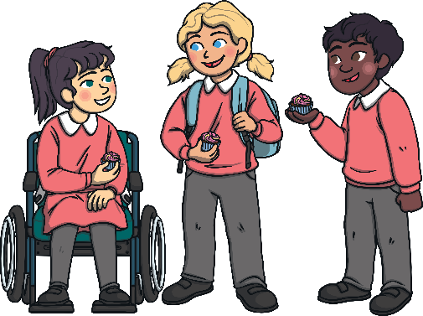

What Do Jeans for Genes Do?
1 in 20 children are born with a genetic condition or birth defect. Jeans for Genes raises money for research, treatments and equipment that these children need.
Supporting Jeans for Genes helps the Medical Research Institute find cures for all the children who live with these medical conditions. Then they can go back to being kids!

Slide 4
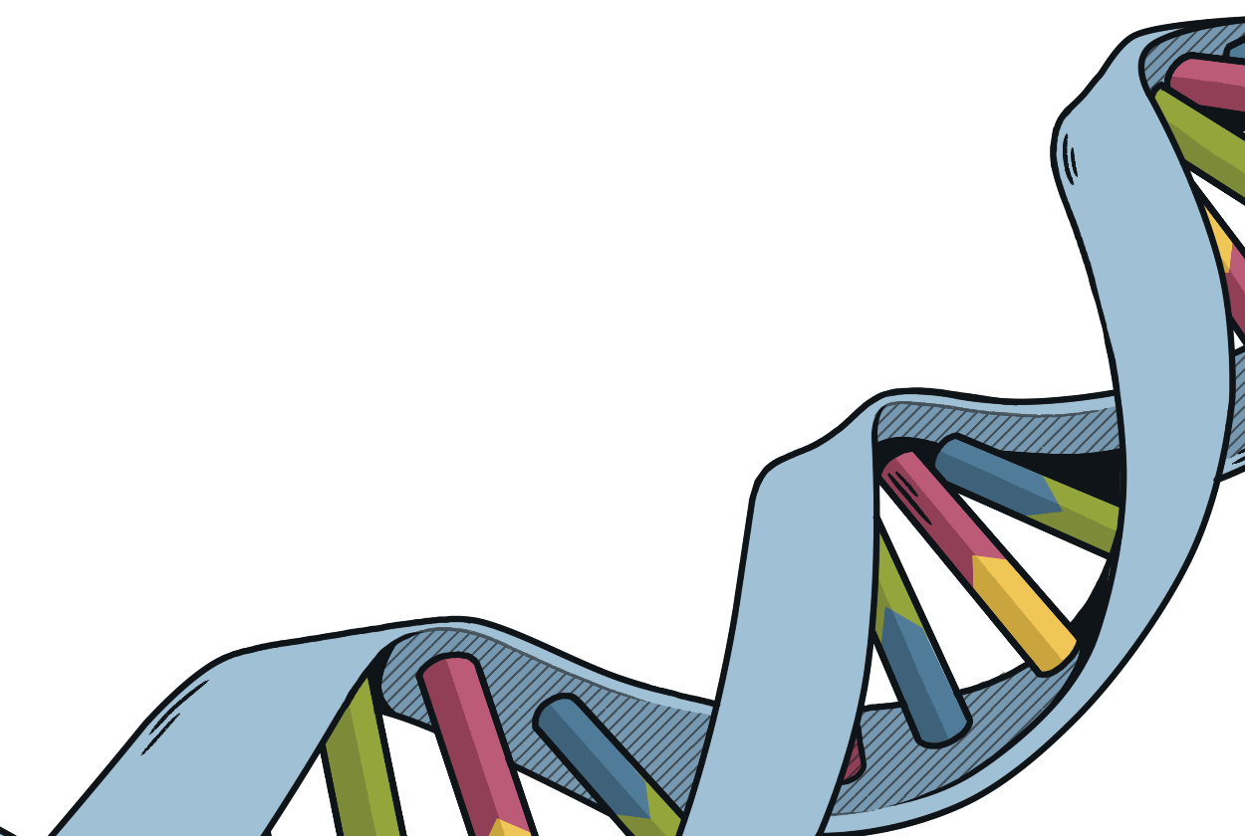
What Is a Genetic Condition?
There are trillions of cells that make up our bodies. Inside the cells there is genetic information. It tells each cell what part of the body it belongs to and what it has to do.
A genetic condition occurs when the information in the cells is wrong.
This means the cells don’t grow or work like they should.

Slide 5


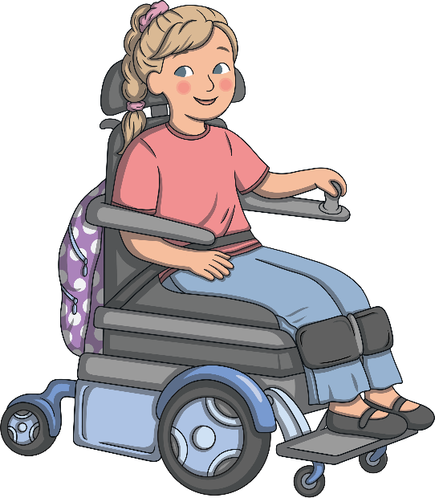
Types of Genetic Conditions
There are many different types of genetic conditions, over 6000 are currently known. Some of these include:
genetic blindness
cystic
fibrosis
haemophilia
cancer
spinal muscular atrophy

Slide 6
Event Details
Dates: September 14 – 20, 2026
How it works: Choose any day during this week to wear denim to school, work, or your community group.
Purpose: Raise donations to support children and families affected by life-altering genetic conditions

Slide 7
What Can You Do?
One easy way to support Jeans for Genes is to wear denim. Each year, Jeans for Genes Day raises money and awareness by asking people to donate and wear their jeans or denim clothing.
You can wear plain denim, lots of denim or decorate your denim with your own unique style.

Slide 8
What Can You Do?
Another great way to support Jeans for Genes is to have a ‘Bake it Blue’ stall. Sell some yummy blue treats and raise money for this great cause.
You can bake blue cakes, make blue jelly or decorate cupcakes with blue icing or sprinkles.

Slide 9
What Can You Do?
If you like to get active, you can join in the Skipping challenge or the Sofa to 6k challenge. You can get more ‘jean-ius’ information on the website here.

Slide 10
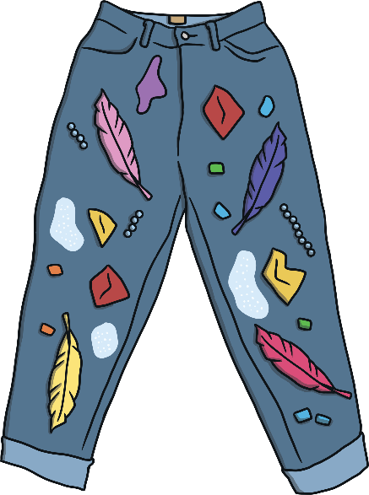
What Can You Do?
Here are some great school or classroom ideas that you can do for Jeans for Genes Day:
Design your own jeans.
Have a denim fashion parade.
Research a genetic condition.
Decorate a pair of old jeans.
Make a poster to promote the day.

Slide 11
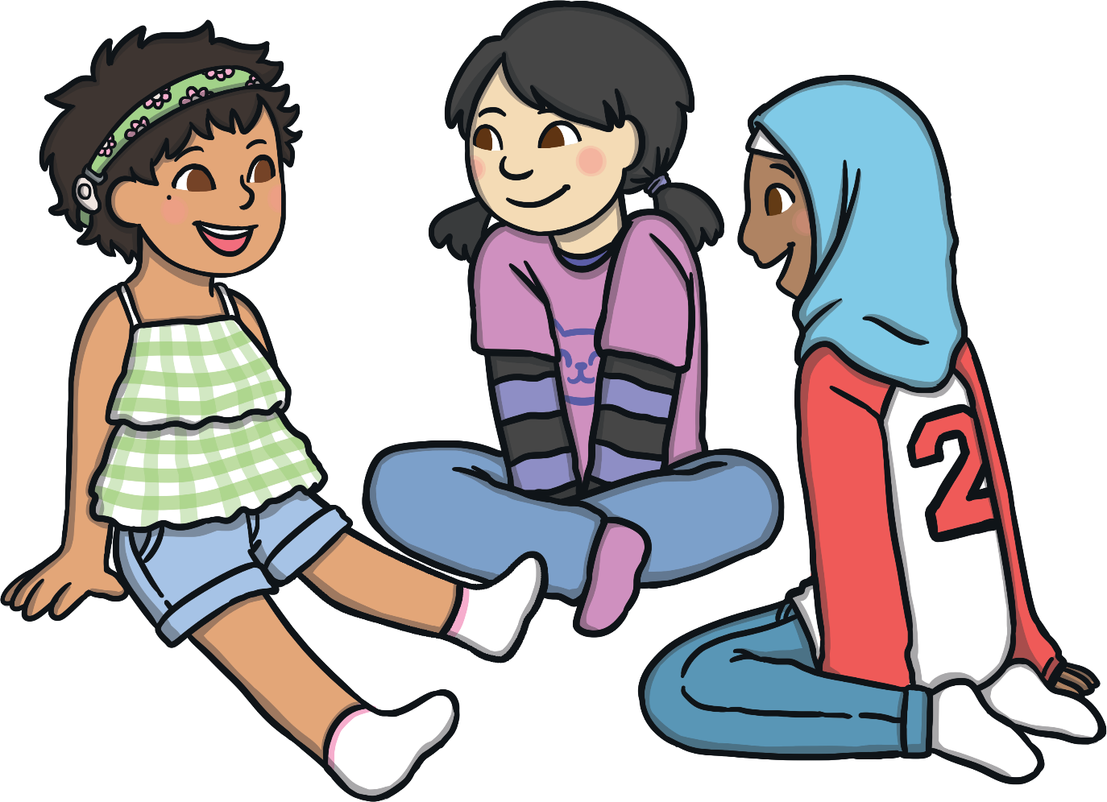
Jeans for Genes is a great charity that helps millions of children who have genetic conditions. By joining in, you can help too!

Slide 12
👖 Jeans for Genes Day – Friday 25th September!
On Friday 25th September, we are all invited to wear our jeans to school and bring a donation of £1 – or more if you would like to!
But here’s the challenge...
We don’t just want you to wear your jeans – we want you to make them UNIQUE!
Why? Because just like our genes, every one of us is unique and special.
So, between now and the 25th, see what you can do to make your jeans a little different. You could decorate them, customise them or add something creative. Please don’t simply swap your uniform for a football kit – the challenge is all about the JEANS!
You could even ask your family to help you raise a little extra money. Remember, no amount is too big or too small – every penny helps.
So, Adamsrill...
How unique can you make YOUR jeans? 👖✨
Let’s have fun, get creative and raise as much as we can for Jeans for Genes Day!

